Slide 1
Unit testing - Best practices
How to write unit test well or don’t write them at all??

Slide 2

Introduction
Sergey Kichuk
skichuk@luxoft.com
Skype: exiton3
http://luxoft-training.ru
http://luxoft-training.com

Slide 3
What are the qualities of good unit test?
Make the tests Trustworthy
Create Maintainable tests
Readable tests

Slide 4
Trustworthy tests

Slide 5
Trustworthy tests
Test the right thing
Make it easy to run
Separation of Unit and Integration tests
Avoid manual Mock logic
Don’t repeat production logic
Write in TDD manner

Slide 6
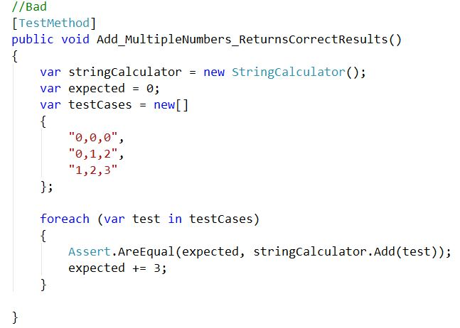
Avoid Logic in Tests :

Slide 7
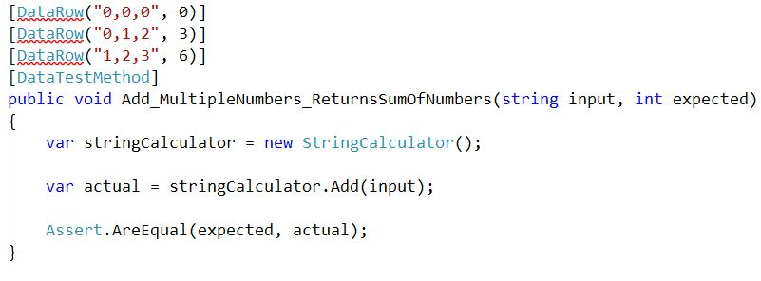
Avoid Logic in Tests :

Slide 8
Maintainable tests

Slide 9
Maintainable tests
Test one thing
Re-use of test code (Create, Make, Init etc)(Demo)
No multiple asserts (except if have to assert properties for on object)
One Mock per test
Enforce test isolation (no dependency between tests)

Slide 10
Readable tests

Slide 11
Naming conventions
The name of test should answer on 3 questions
What do we test?
What is the scenario or input state?
What is expected result or behavior?

Slide 12
Naming conventions
The name of your test should consist of 3 parts:
The name of the method being tested.
The scenario under test or input state
The expected behavior when the scenario is invoked.

Slide 13
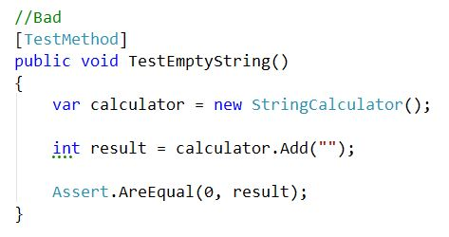
Naming conventions :

Slide 14
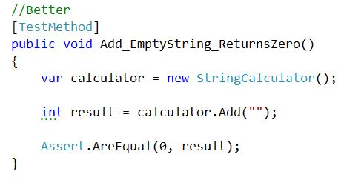
Naming conventions :

Slide 15
AAA - pattern:
Arrange, Act, Assert is a common pattern when unit testing. As the name implies, it consists of three main actions:
Arrange your objects, creating and setting them up as necessary.
Act on an object.
Assert that something is as expected.

Slide 16
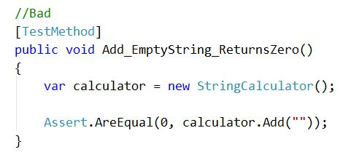
AAA - pattern:

Slide 17
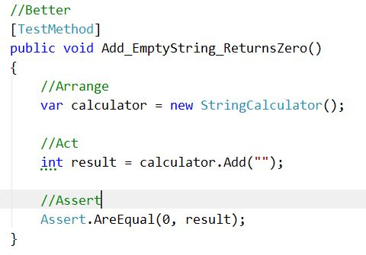
AAA - pattern:

Slide 18
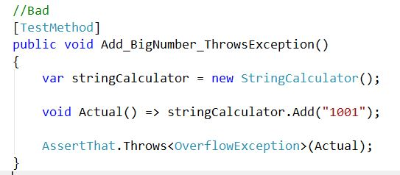
Magic values:

Slide 19
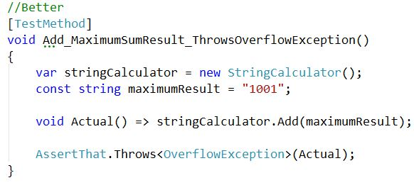
Magic values:

Slide 20
Tests Structure
One Test assembly per Code assembly.
Name of Test class should be same as tested class with postfix ‘Tests’

Slide 21
Color Gamma

